Slide 1
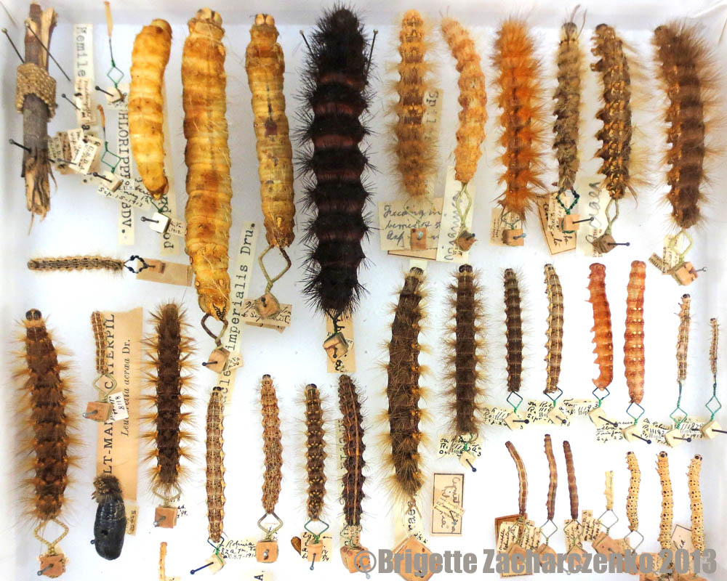
Taxonomy, systematics and phylogenies

Slide 2
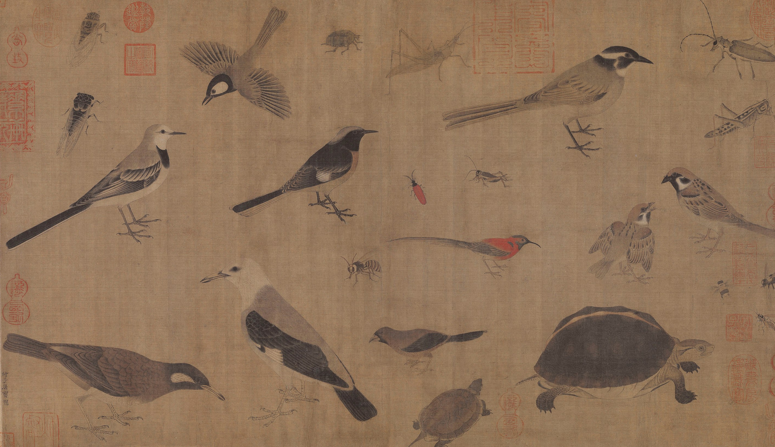
The problem:
There are millions of species
A classification system
The Solution:

Slide 3
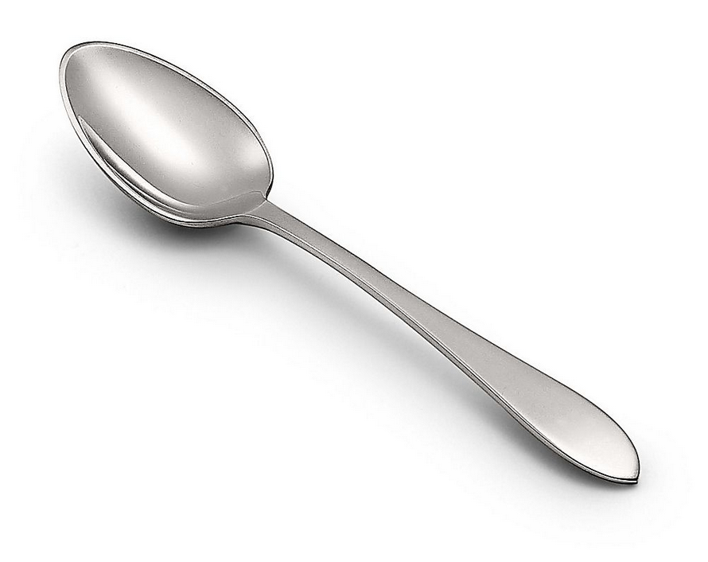

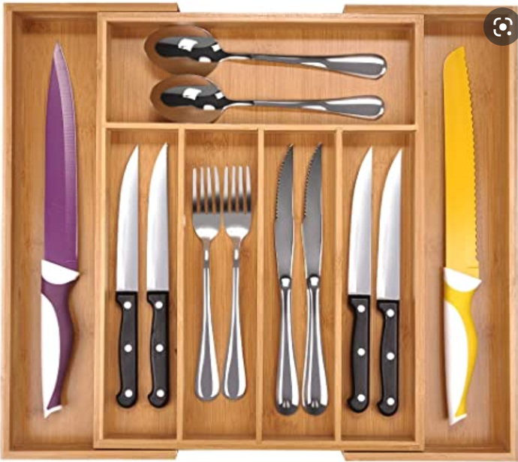

Example
Naming
Organism
If you found it first, you get to name it
Spoon
Classification
Cutlery organizer

Slide 4
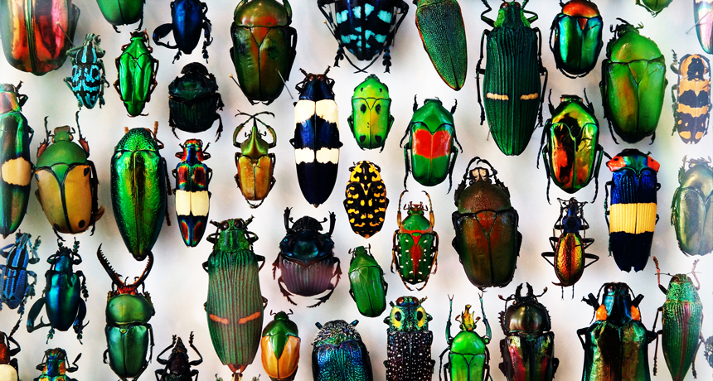
Taxonomy
(the study of naming, and classifying groups of biological organisms)
Naming
Grouping/Placing/Classifying

Slide 5
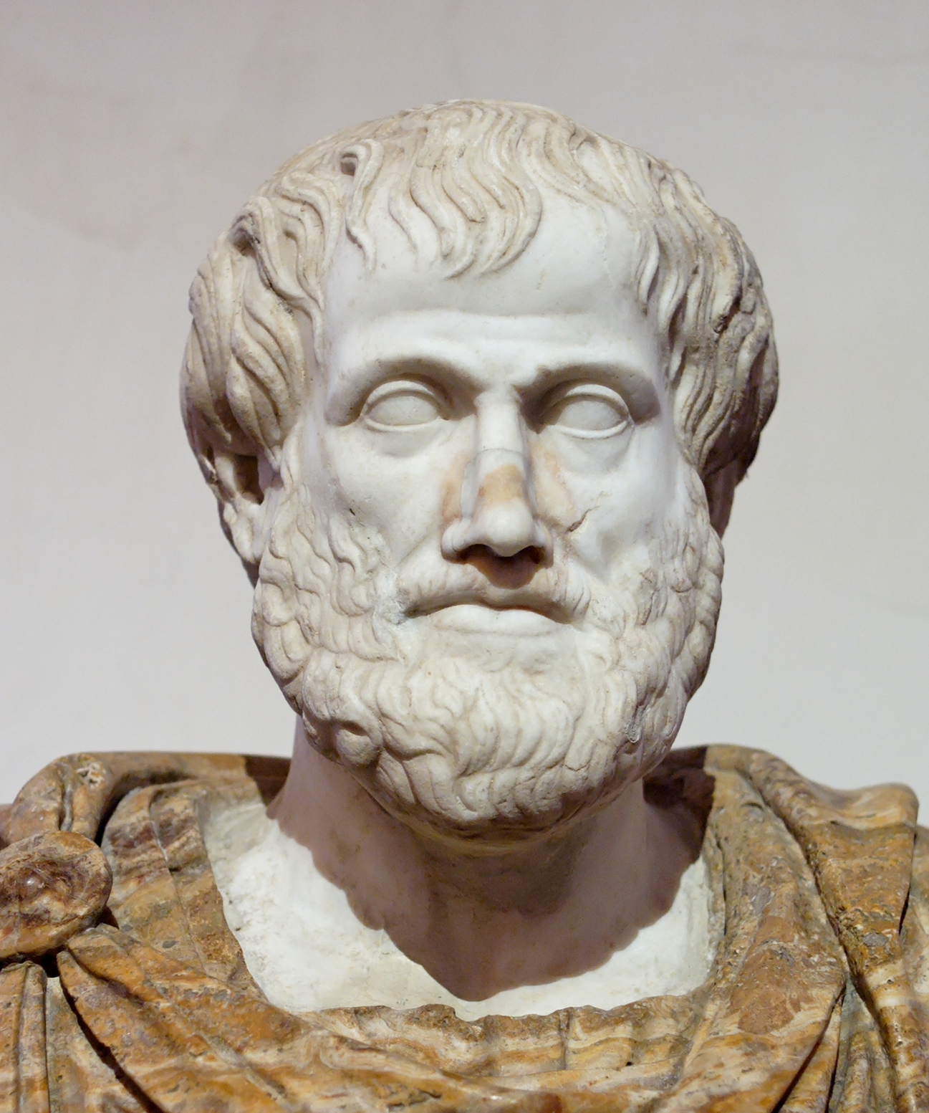
The Aristotelian system
Aristotle (Greece, 384–322 BC)
First to classify organisms
Naming
Based on their parts: has four legs, laying eggs, etc.
Grouping
He group living things into:
Plants
Animals
Plant Subgroups: Small, Medium, Large
Animal Subgroups: Land, Water, Air

Slide 6
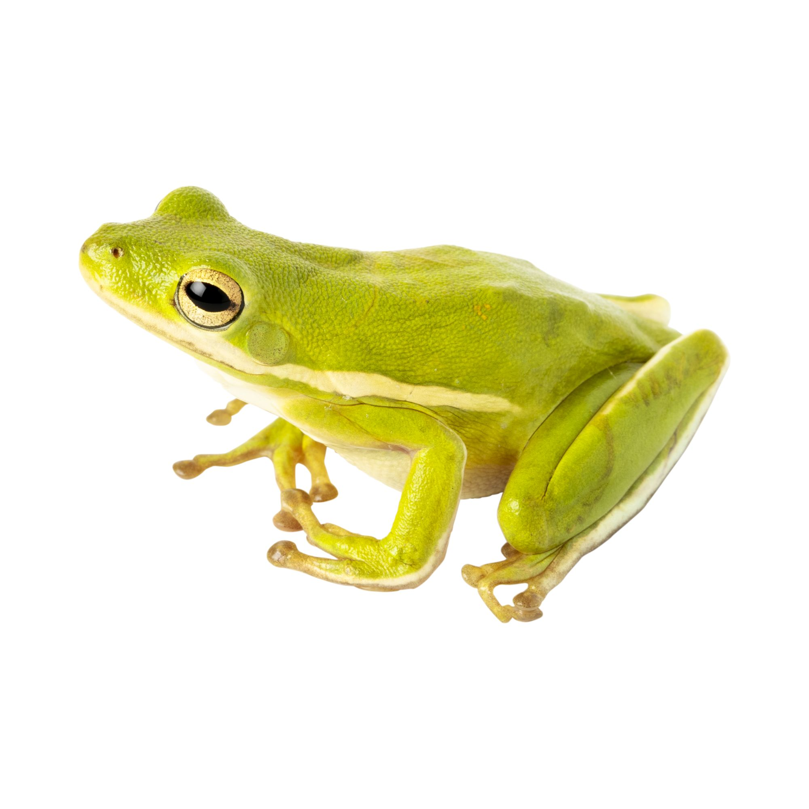
The Aristotelian system was not very good
There were too many organisms that didn’t fit
?
The Aristotelian system:
Animals
Subgroups: Land, Water, Air
Adult
Young

Slide 7
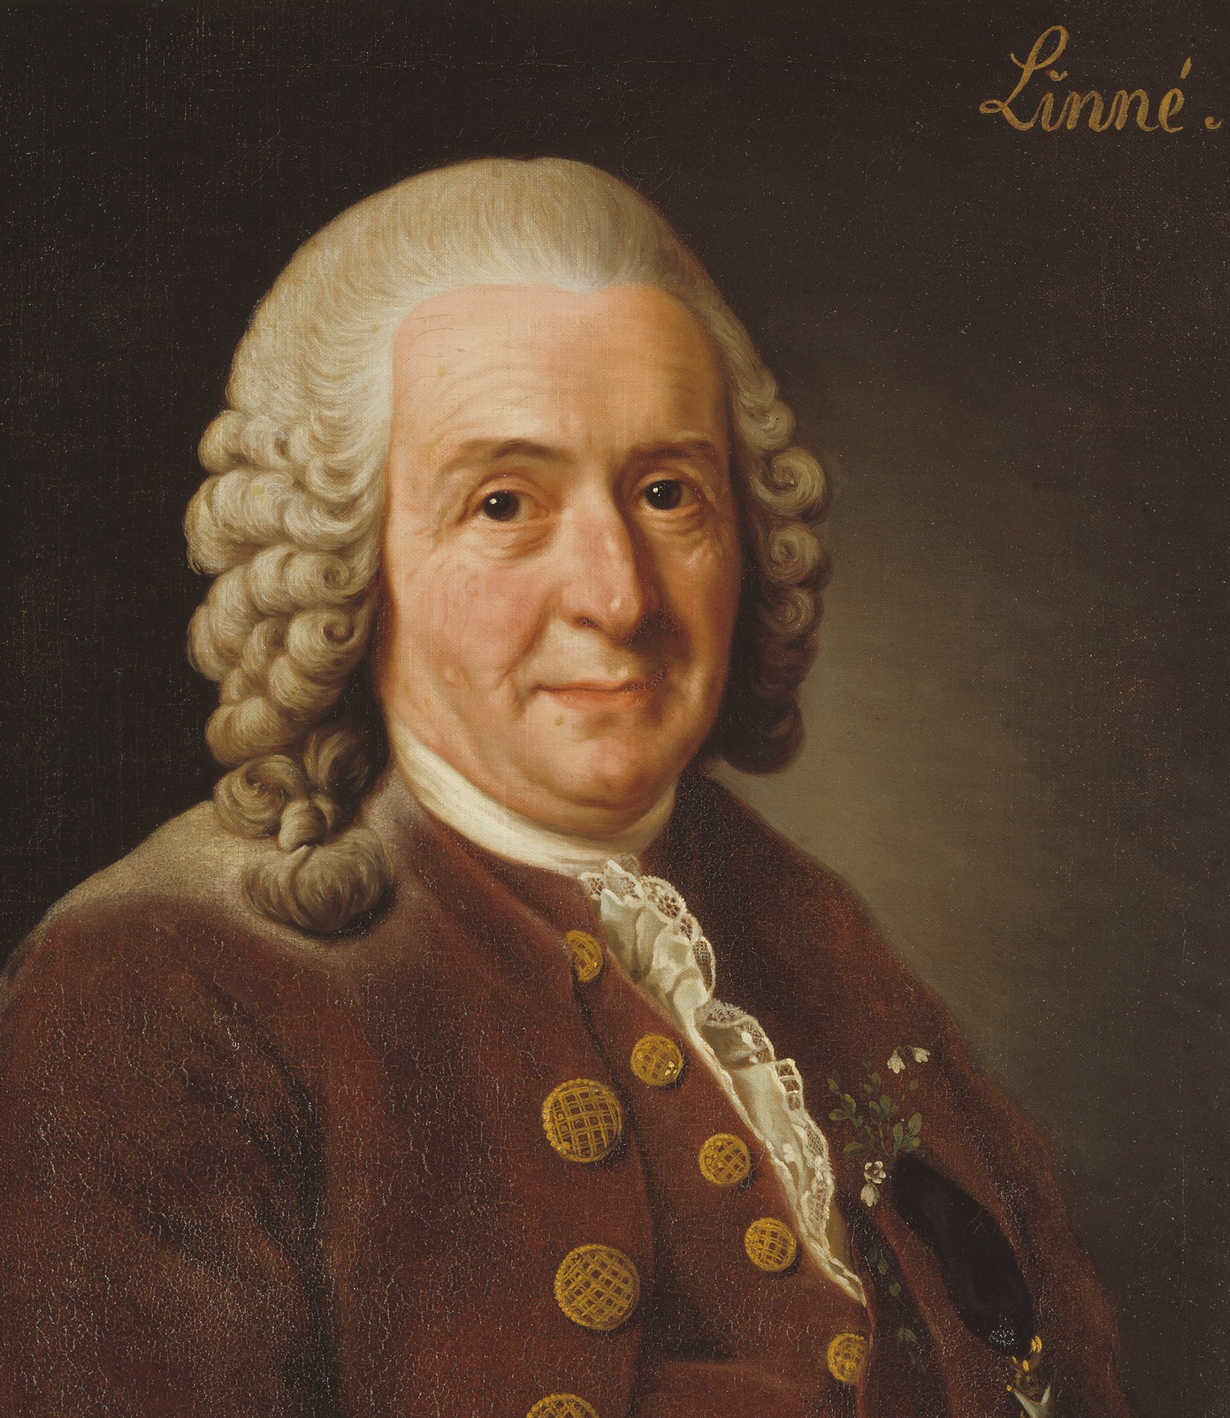
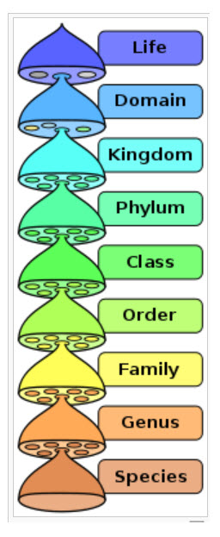
The Linnaean Classification System
Carolus Linnaeus (1700’s)
Father of taxonomy
Naming
Binomial naming system:
Genus
+ specific name (Specific epithet)
Homo sapiens
Grouping
Taxonomic hierarchy
Groupings based on structural similarities
Notes:
and it has two parts. The first part of the species name identifies the genus to which the species belongs; the second part identifies the species within the genus.

Slide 8
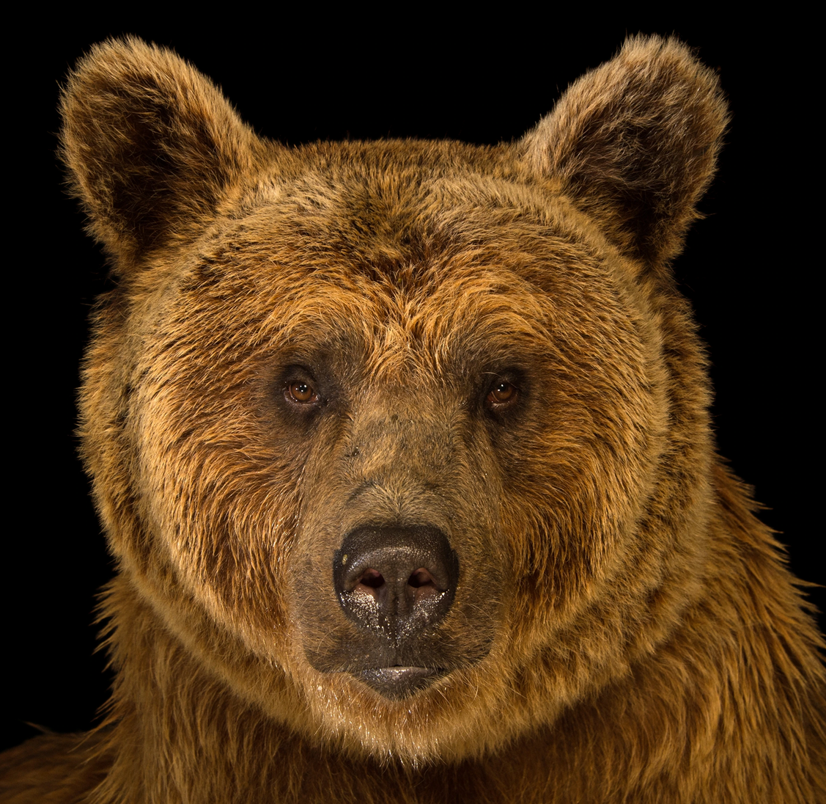
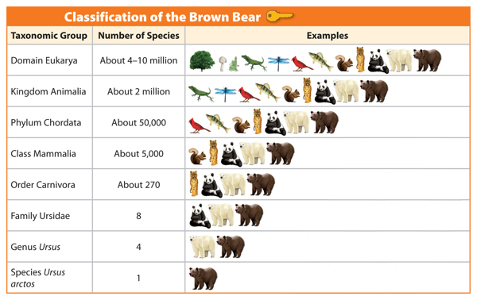

Slide 9
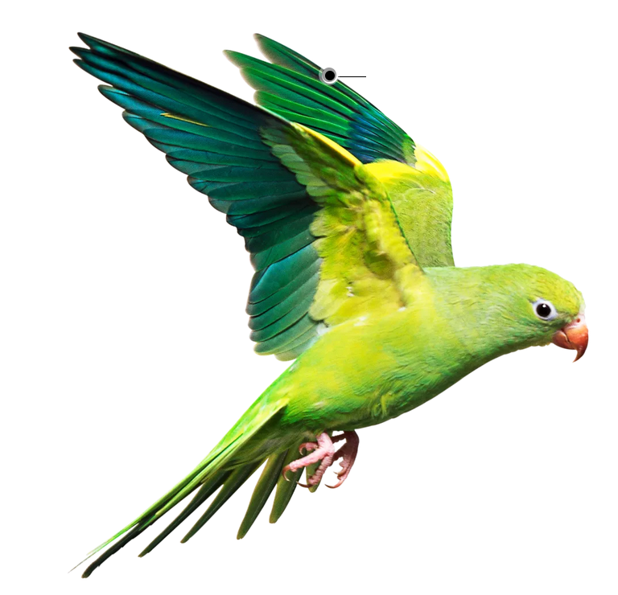
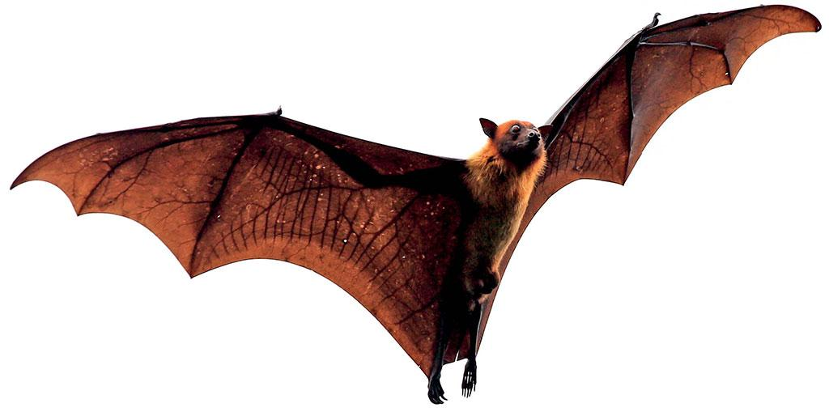
The original Linnaean system was not perfect
Original Linnaean system
Same group

Slide 10
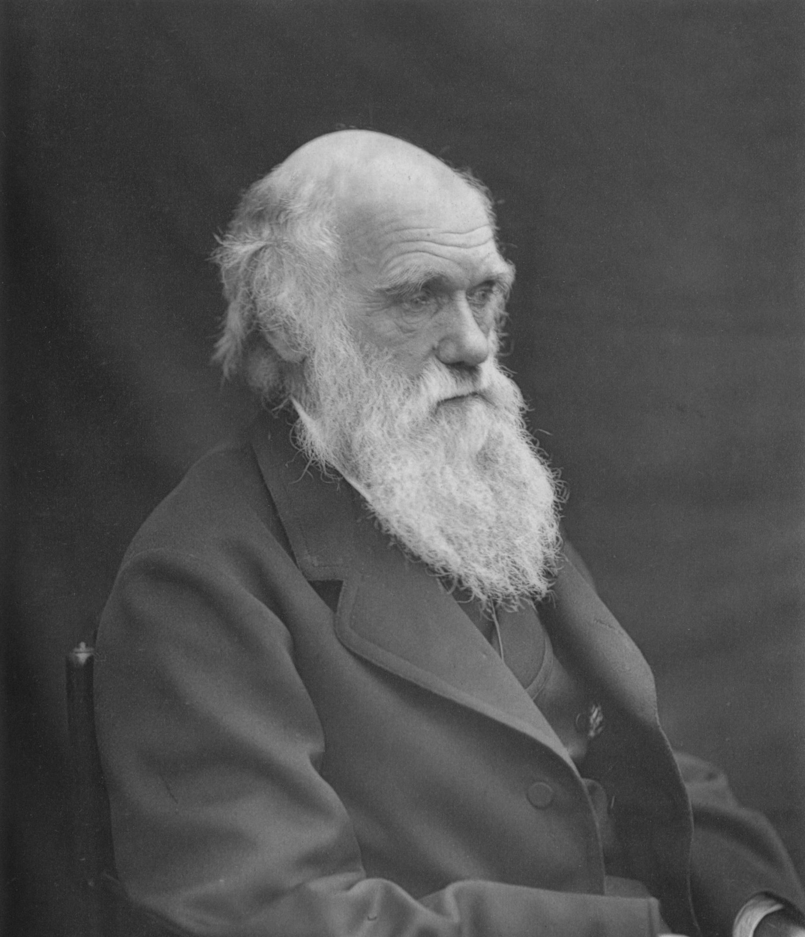
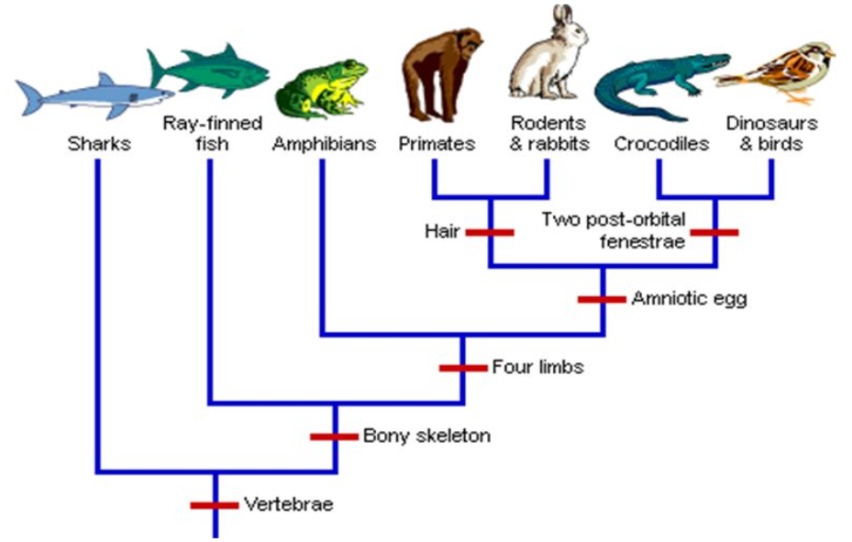
Cladistic classification
Evolutionary taxonomy
Charles Darwin (1850’s)
All species of life have descended from a common ancestor
Naming
Binomial naming system:
genus + specific name (Specific epithet)
Grouping
Principle of common descent

Slide 11
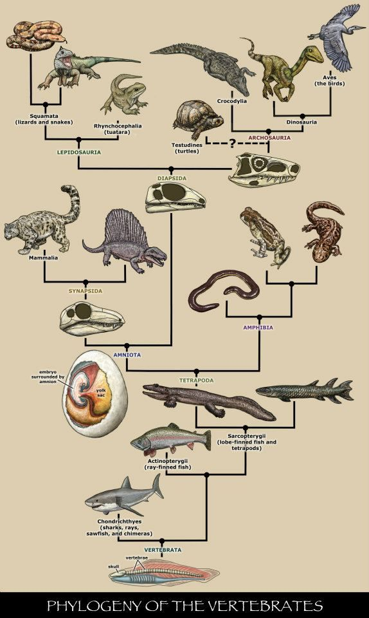
Improvement of the cladistic classification
Cladistic
system
Original Linnaean system
Same group

Slide 12
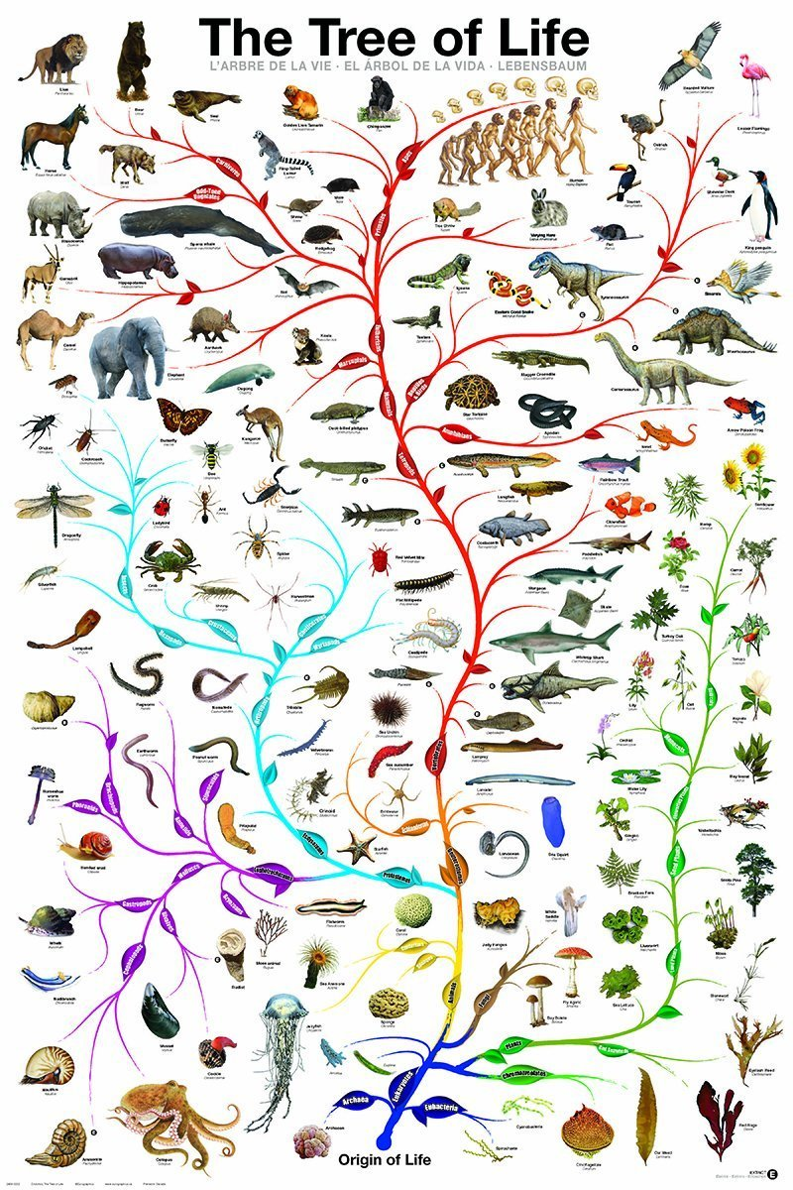
Systematics
Classification of organisms based on their evolution
Species
Linnaeus and Darwin coming together
Genus
Family
Order
Class
Phylum
Kingdom
Domain

Slide 13
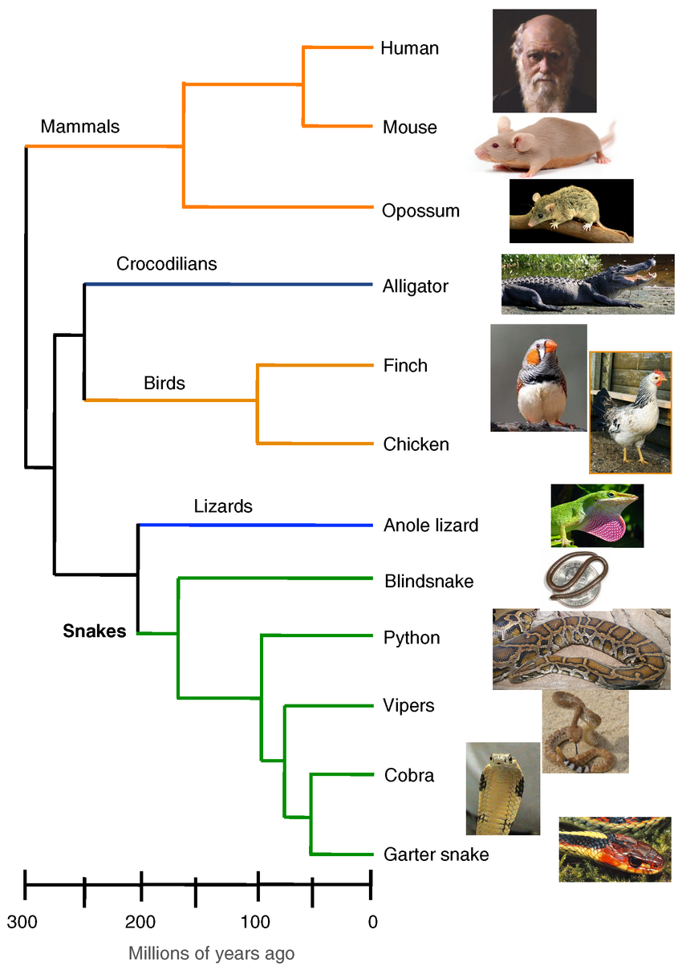
Phylogeny:
history of the evolution of a species or group/ evolutionary relationships
Phylogenetics:
study of the reconstructing the past evolutionary history of species or taxa

Slide 14
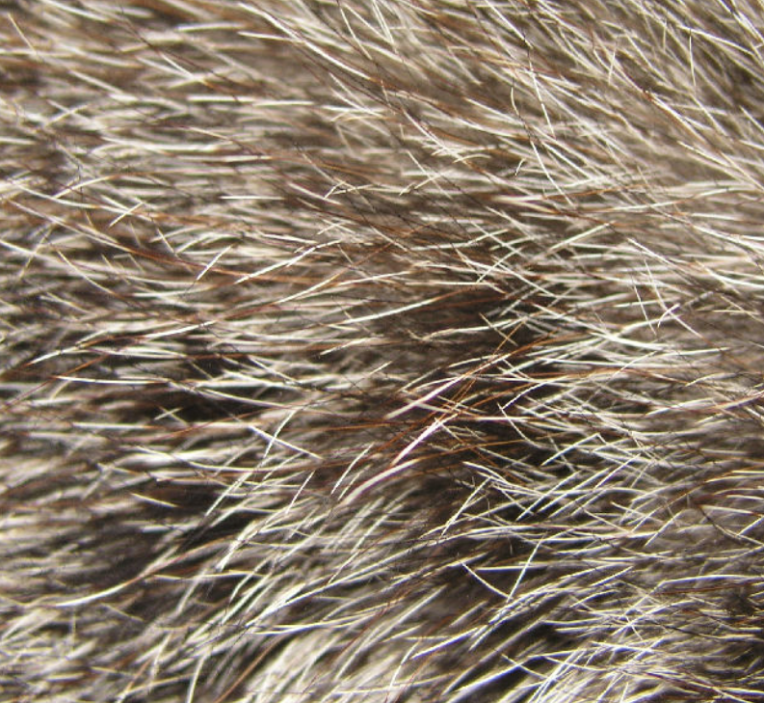
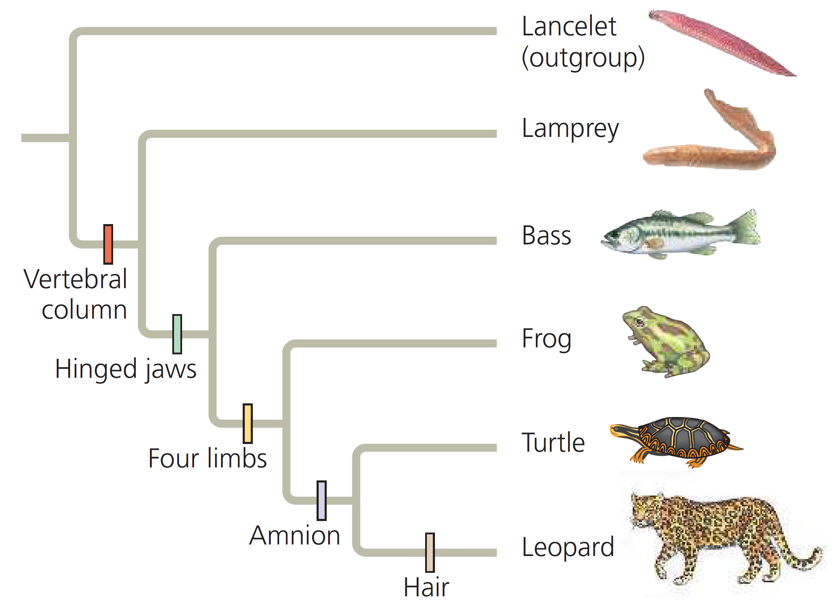
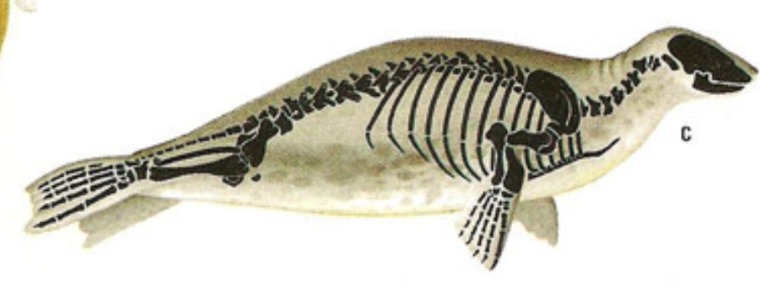
How are phylogenies made: Shared ancestral and shared derive characters
As a result of descent with modification, organisms have characters they share with their ancestors (shared ancestral), and they also have characters that differ from those of their ancestors (shared derived characters).
Hair:
Hair is a character shared by all mammals but not found in their ancestors. Thus, in mammals, hair is a shared derived character, an evolutionary novelty unique to a clade.
Backbones:
The backbone predates the branching of mammals
from other vertebrates, thus, for mammals, the backbone is a shared ancestral character, a character that originated in an ancestor taxon.

Slide 15
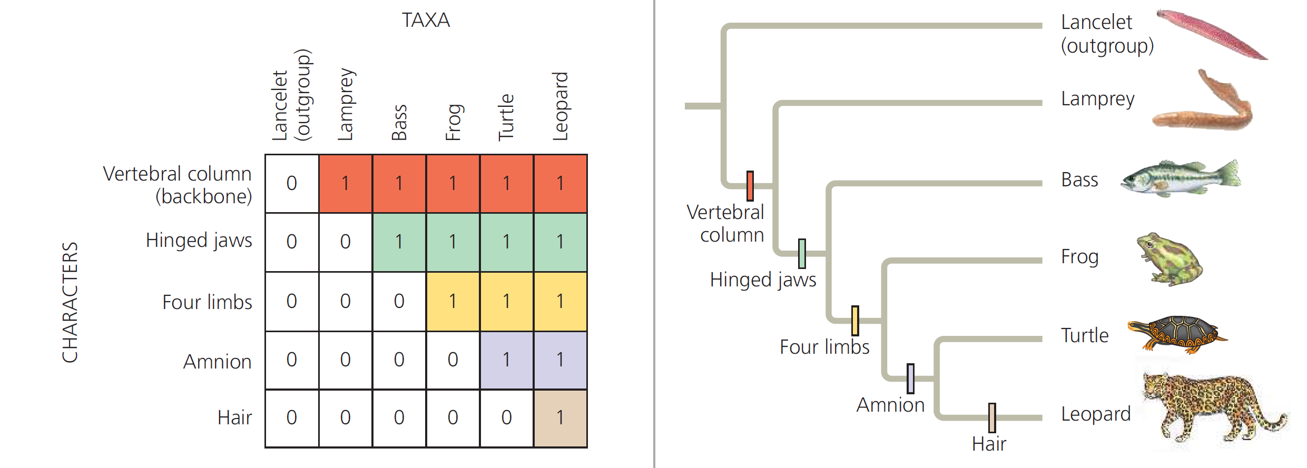
How are phylogenies made: using derived characters

Slide 16
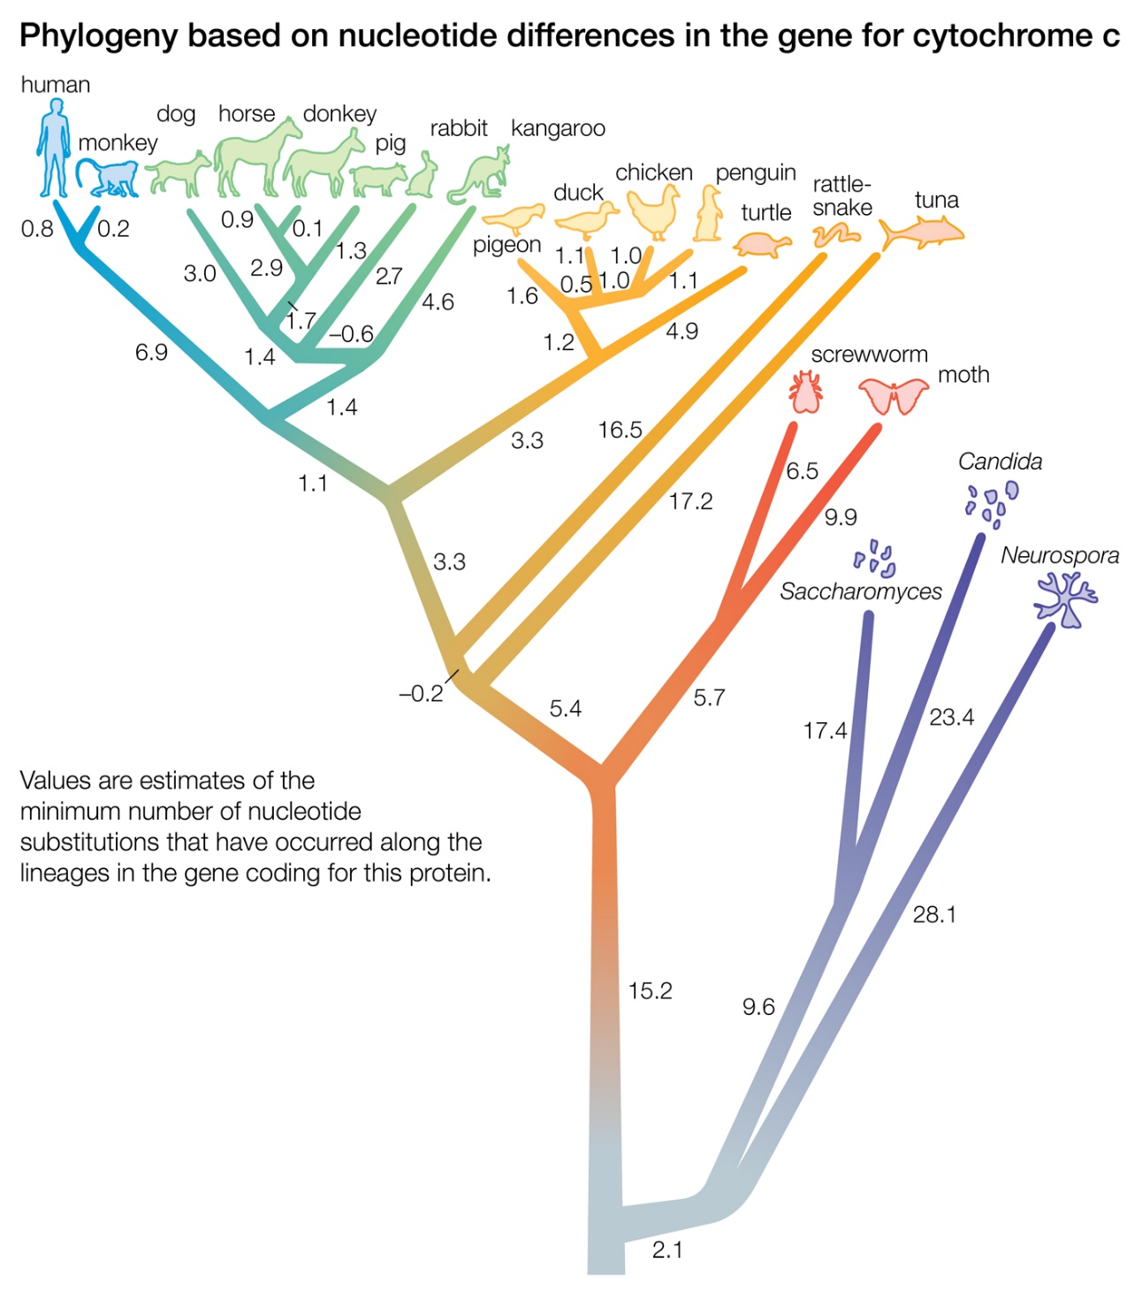
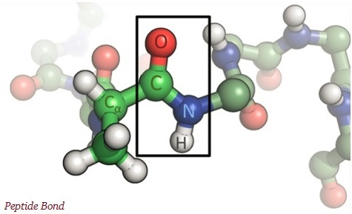
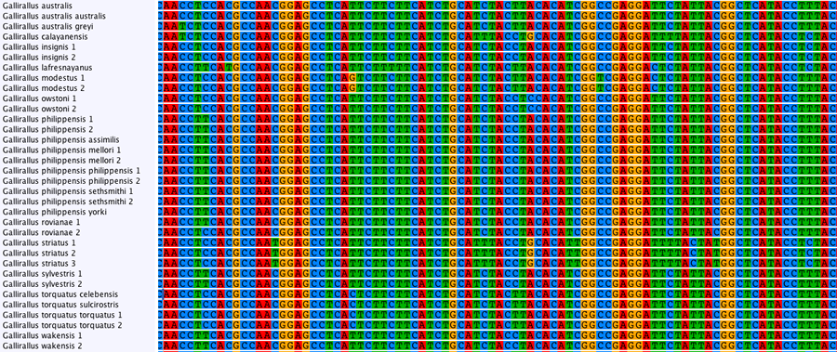
How are phylogenies made: molecules (proteins, DNA)

Slide 17
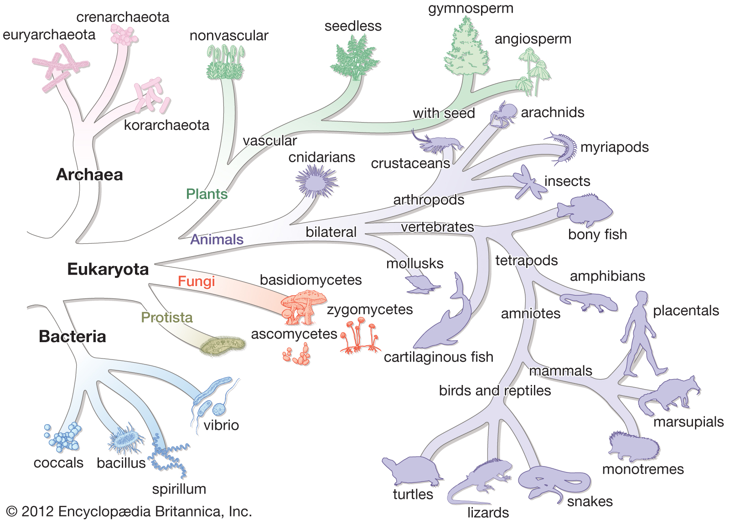
Tree of life:

Slide 18
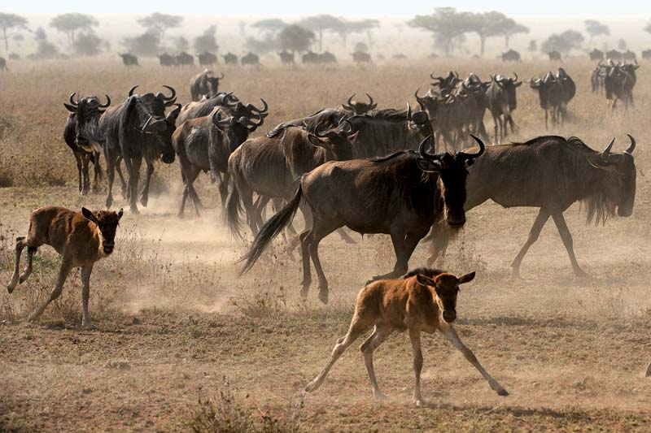
So, what is a species then?
26 recognized species concepts(Wilkins, 2006)
Biological Species Concept defines a species as a group of organisms that can successfully interbreed and produce fertile offspring.

Slide 19
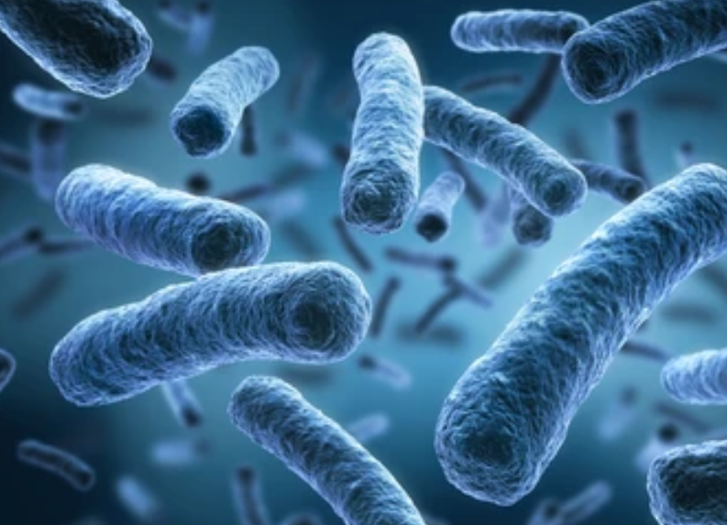
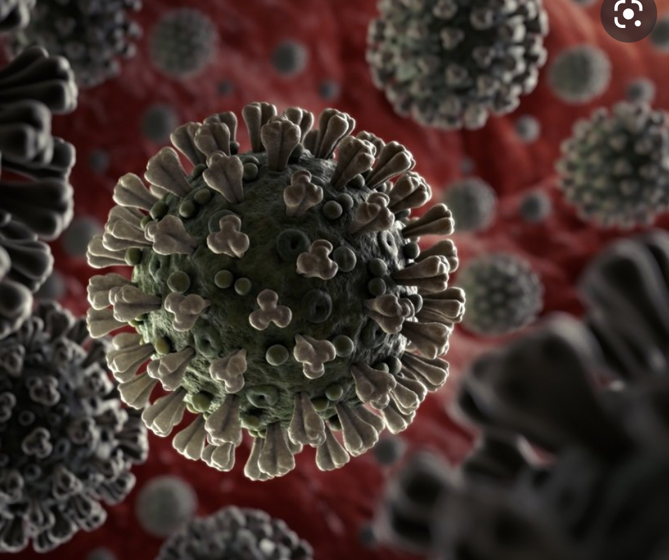
Problems with Biological Species Concept:
Asexual reproduction
Bacteria
Viruses

Slide 20
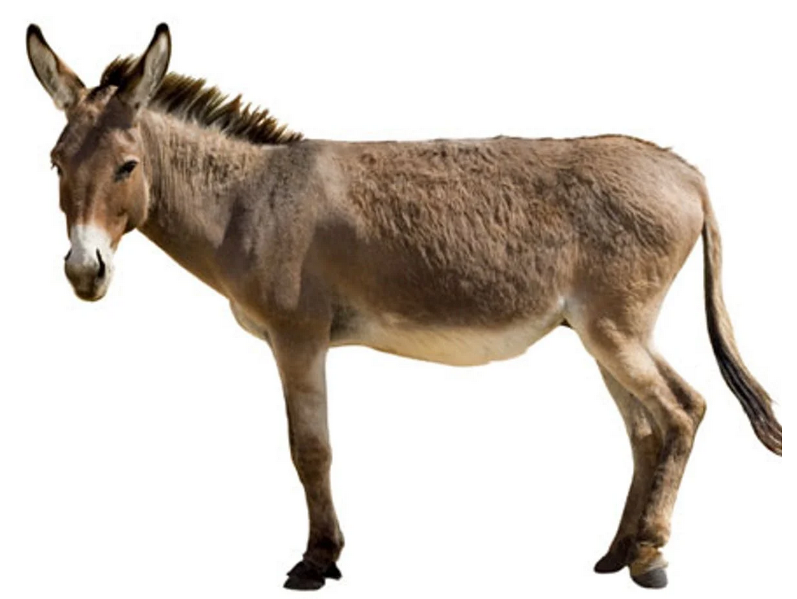
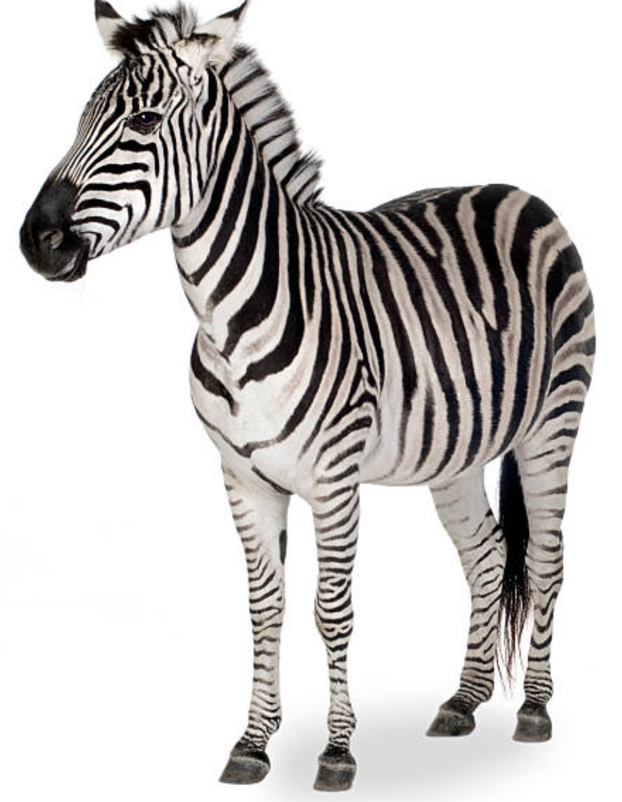
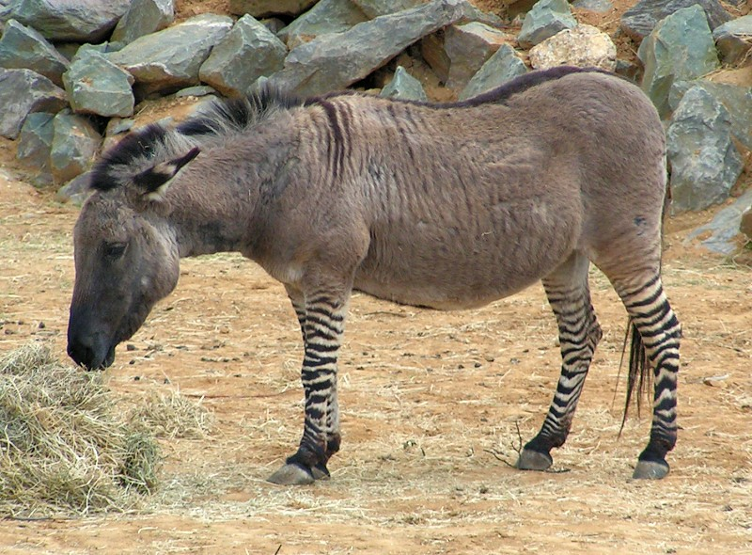
Problems with Biological Species Concept:
Hybridization
“Viable” offprint between two different “species”
Zonkey
=

Slide 21
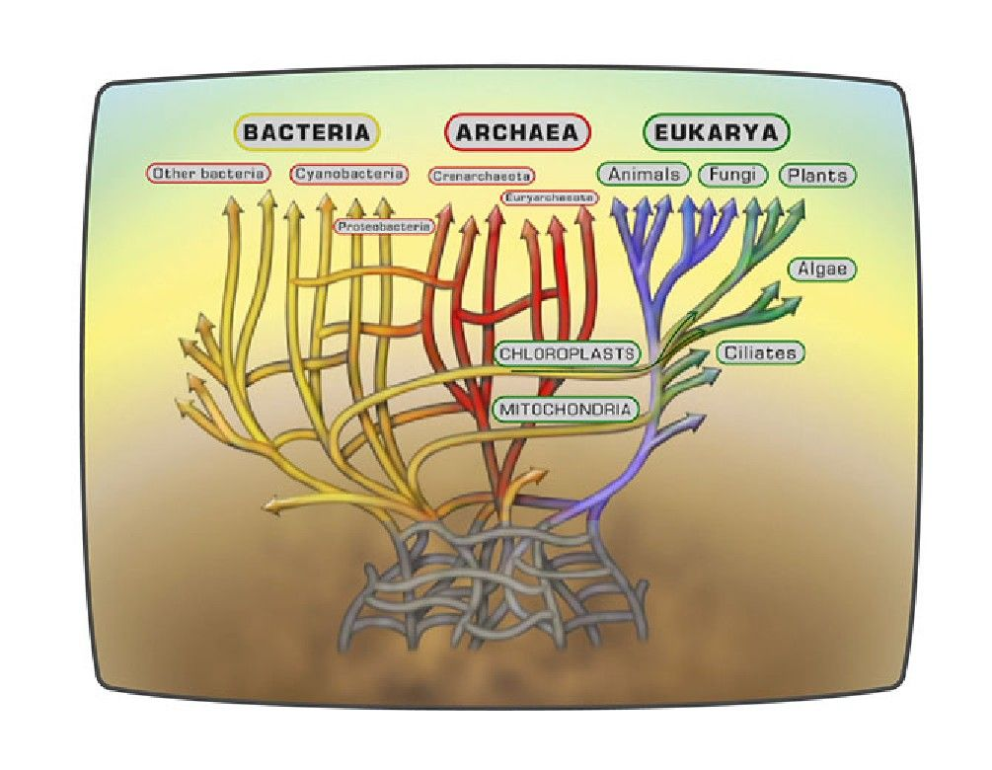
Problems with Biological Species Concept:
Horizontal gene transfer

Slide 22
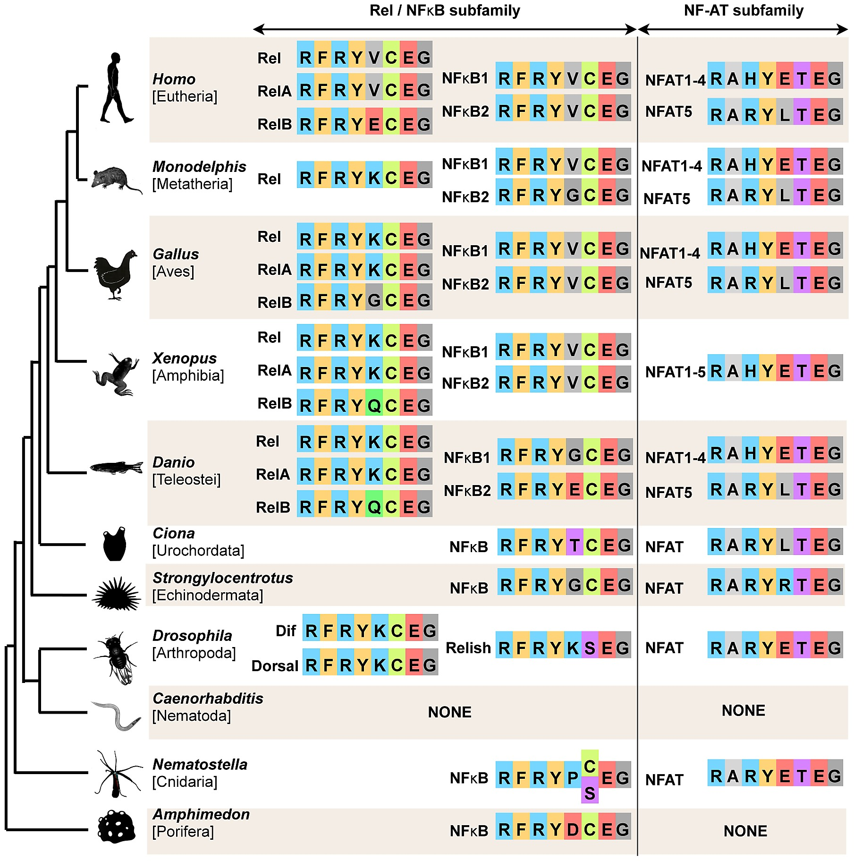
So, what is a species then?
Genetic Species Concept group of organisms within certain amount of genetic similarity.

Slide 23

Problems with Genetic Species Concept:
What threshold to use?

Slide 24
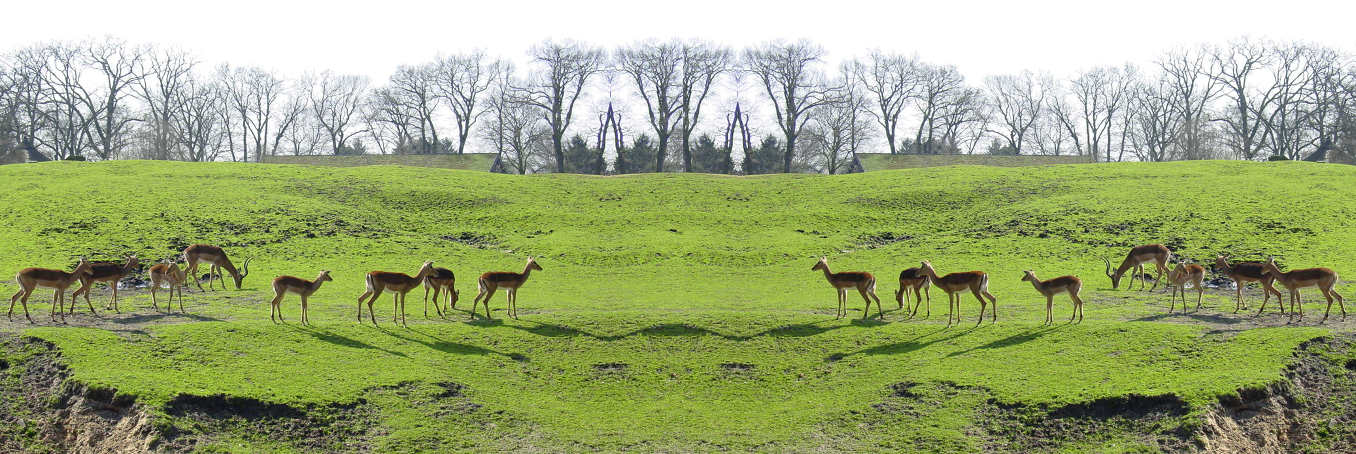
Clarification: Species vs Population
Same species
Different populations

